Slide 1
GRAPH
www.csemcq.com

Slide 2
Graph- A graph G consists of :
  A set V of elements called the nodes (or points or vertices)
  A set E of edges such that each edge e in E is identified with a unique (unordered) pair [u,v] of nodes in V, denoted by e=[u,v]
The nodes u and v are called the end points of e or adjacent nodes or neighbors.
The edge in a graph can be directed or undirected depending on whether the direction of the edge is specified or not.
A graph in which each edge is directed is called a directed graph or digraph.
A graph in which each edge is undirected is called undirected graph.
A graph which contains both directed and undirected edges is called mixed graph.
Let G=(V,E) be a graph and e є E be a directed edge associated with ordered pair of vertices (v₁,v₂). Then the edge e is said to be initiating from v₁ to v₂. v₁ is the starting and v₂ is the termination of the edge e.
www.csemcq.com

Slide 3
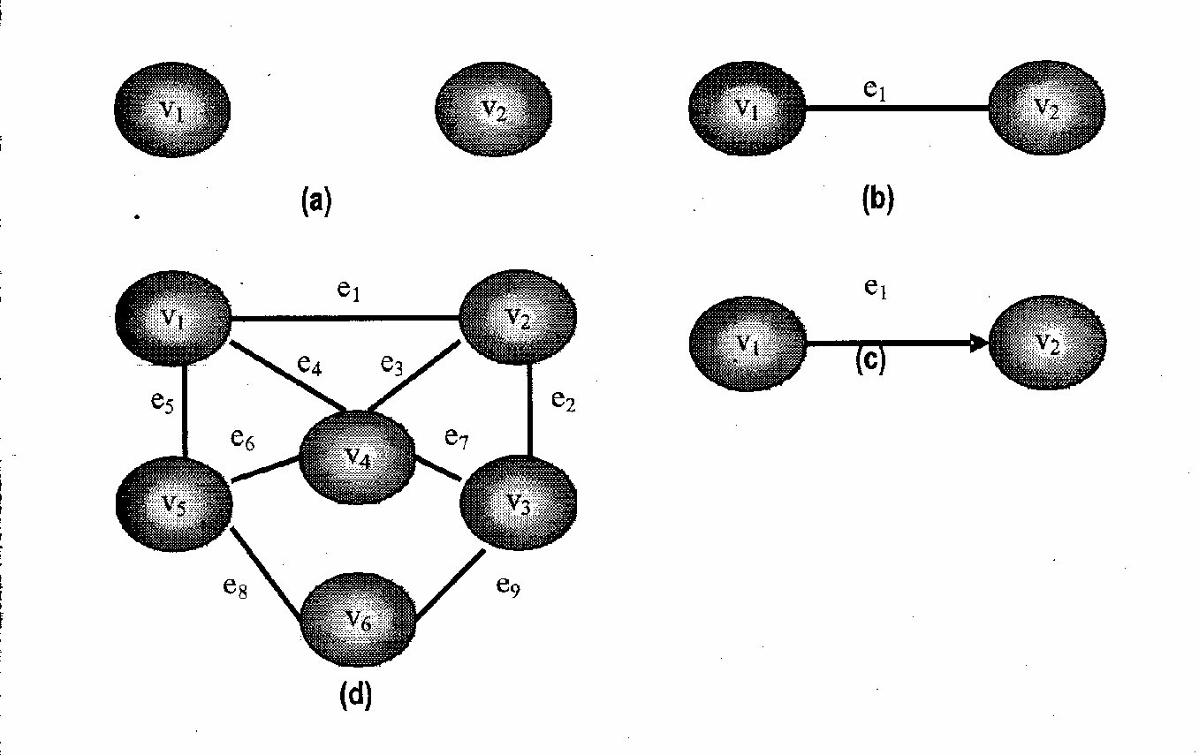
www.csemcq.com

Slide 4
An edge in a graph that joins a vertex to itself is called a sling or a loop
The degree of a node or vertex u is written deg(u) is the number of edges containing u. The degree of a loop is 2
In a directed graph for any vertex v the number of edges which have v as their initial vertex is called the out-degree of v. The number of edges which have v as their terminal vertex is called the in-degree of v. The sum of in-degree and out-degree of a vertex is called the degree of that vertex. If deg(u)=0, then u is called an isolated node and a graph containing only isolated node is called a null graph
The maximum degree of a graph G, denoted by Δ(G), is the maximum degree of its vertices, and the minimum degree of a graph, denoted by δ(G), is the minimum degree of its vertices.
A sequence of edges of a digraph such that the terminal vertex of the edge sequences in the initial vertex of the next edge, if exist, is called a path
E={(v₁,v₂),(v₂,v₃),(v₃,v₄)}
A path P of length n from a vertex u to vertex v is defined as sequence of n+1 nodes
P=(v₀,v₁,v₂--------------v_{n})
such that u=v₀; v_{i-1} is adjacent to v_{i} for i=1,2,3----------n; and v=v_{n}.
The path is said to be closed or a circular path if v₀=v_{n}.
www.csemcq.com

Slide 5
The path is said to be simple if all nodes are distinct, with the exception that v₀ may equal v_{n}; that is P is simple if the nodes v₀,v₁,v₂--------v_{n-1} are distinct and the nodes v₁,v₂------------v_{n} are distinct.
A cycle is closed simple path with length 2 or more. A cycle of length k is called a k-cycle.
A graph G is said to be connected if and only if there is a simple path between any two nodes in G. In other words, a graph is connected if it does not contain any isolated vertices. A graph that is not connected can be divided into connected components (disjoint connected subgraphs). For example, this graph is made of three connected components
A graph G is said to be complete if every node u in G is adjacent to every node v in G. A complete graph with n vertices (denoted Kn) is a graph with n vertices in which each vertex is connected to each of the others (with one edge between each pair of vertices). In other words, there is path from every vertex to every other vertex. Clearly such a graph is also a connected graph.
A complete graph with n nodes will have n(n-1)/2 edges
A connected graph without any cycles is called a tree graph or free graph or simply a tree.
www.csemcq.com

Slide 6
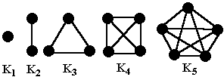
Here are the five complete graphs:
www.csemcq.com

Slide 7
A graph is said to be labeled if its edges are assigned data. G is said to be weighted if each edge e in G is assigned a non negative numerical value w (e) called the weight or length of e.
In such a case, each path P in G is assigned a weight or length which is the sum of the weights of the edges along the path P. If no weight is specified, it is assumed that each edge has the weight w (e) =1
Multiple edges- Distinct edges e and e’ are called multiple edges if they connect the same endpoints, that is, if e=[u, v] and e’=[u, v]. Such edges are also called parallel edges and a graph that contains these multiple or parallel edges is called a multigraph. Also a graph containing loops is also not a simple graph but a multigraph.
www.csemcq.com

Slide 8
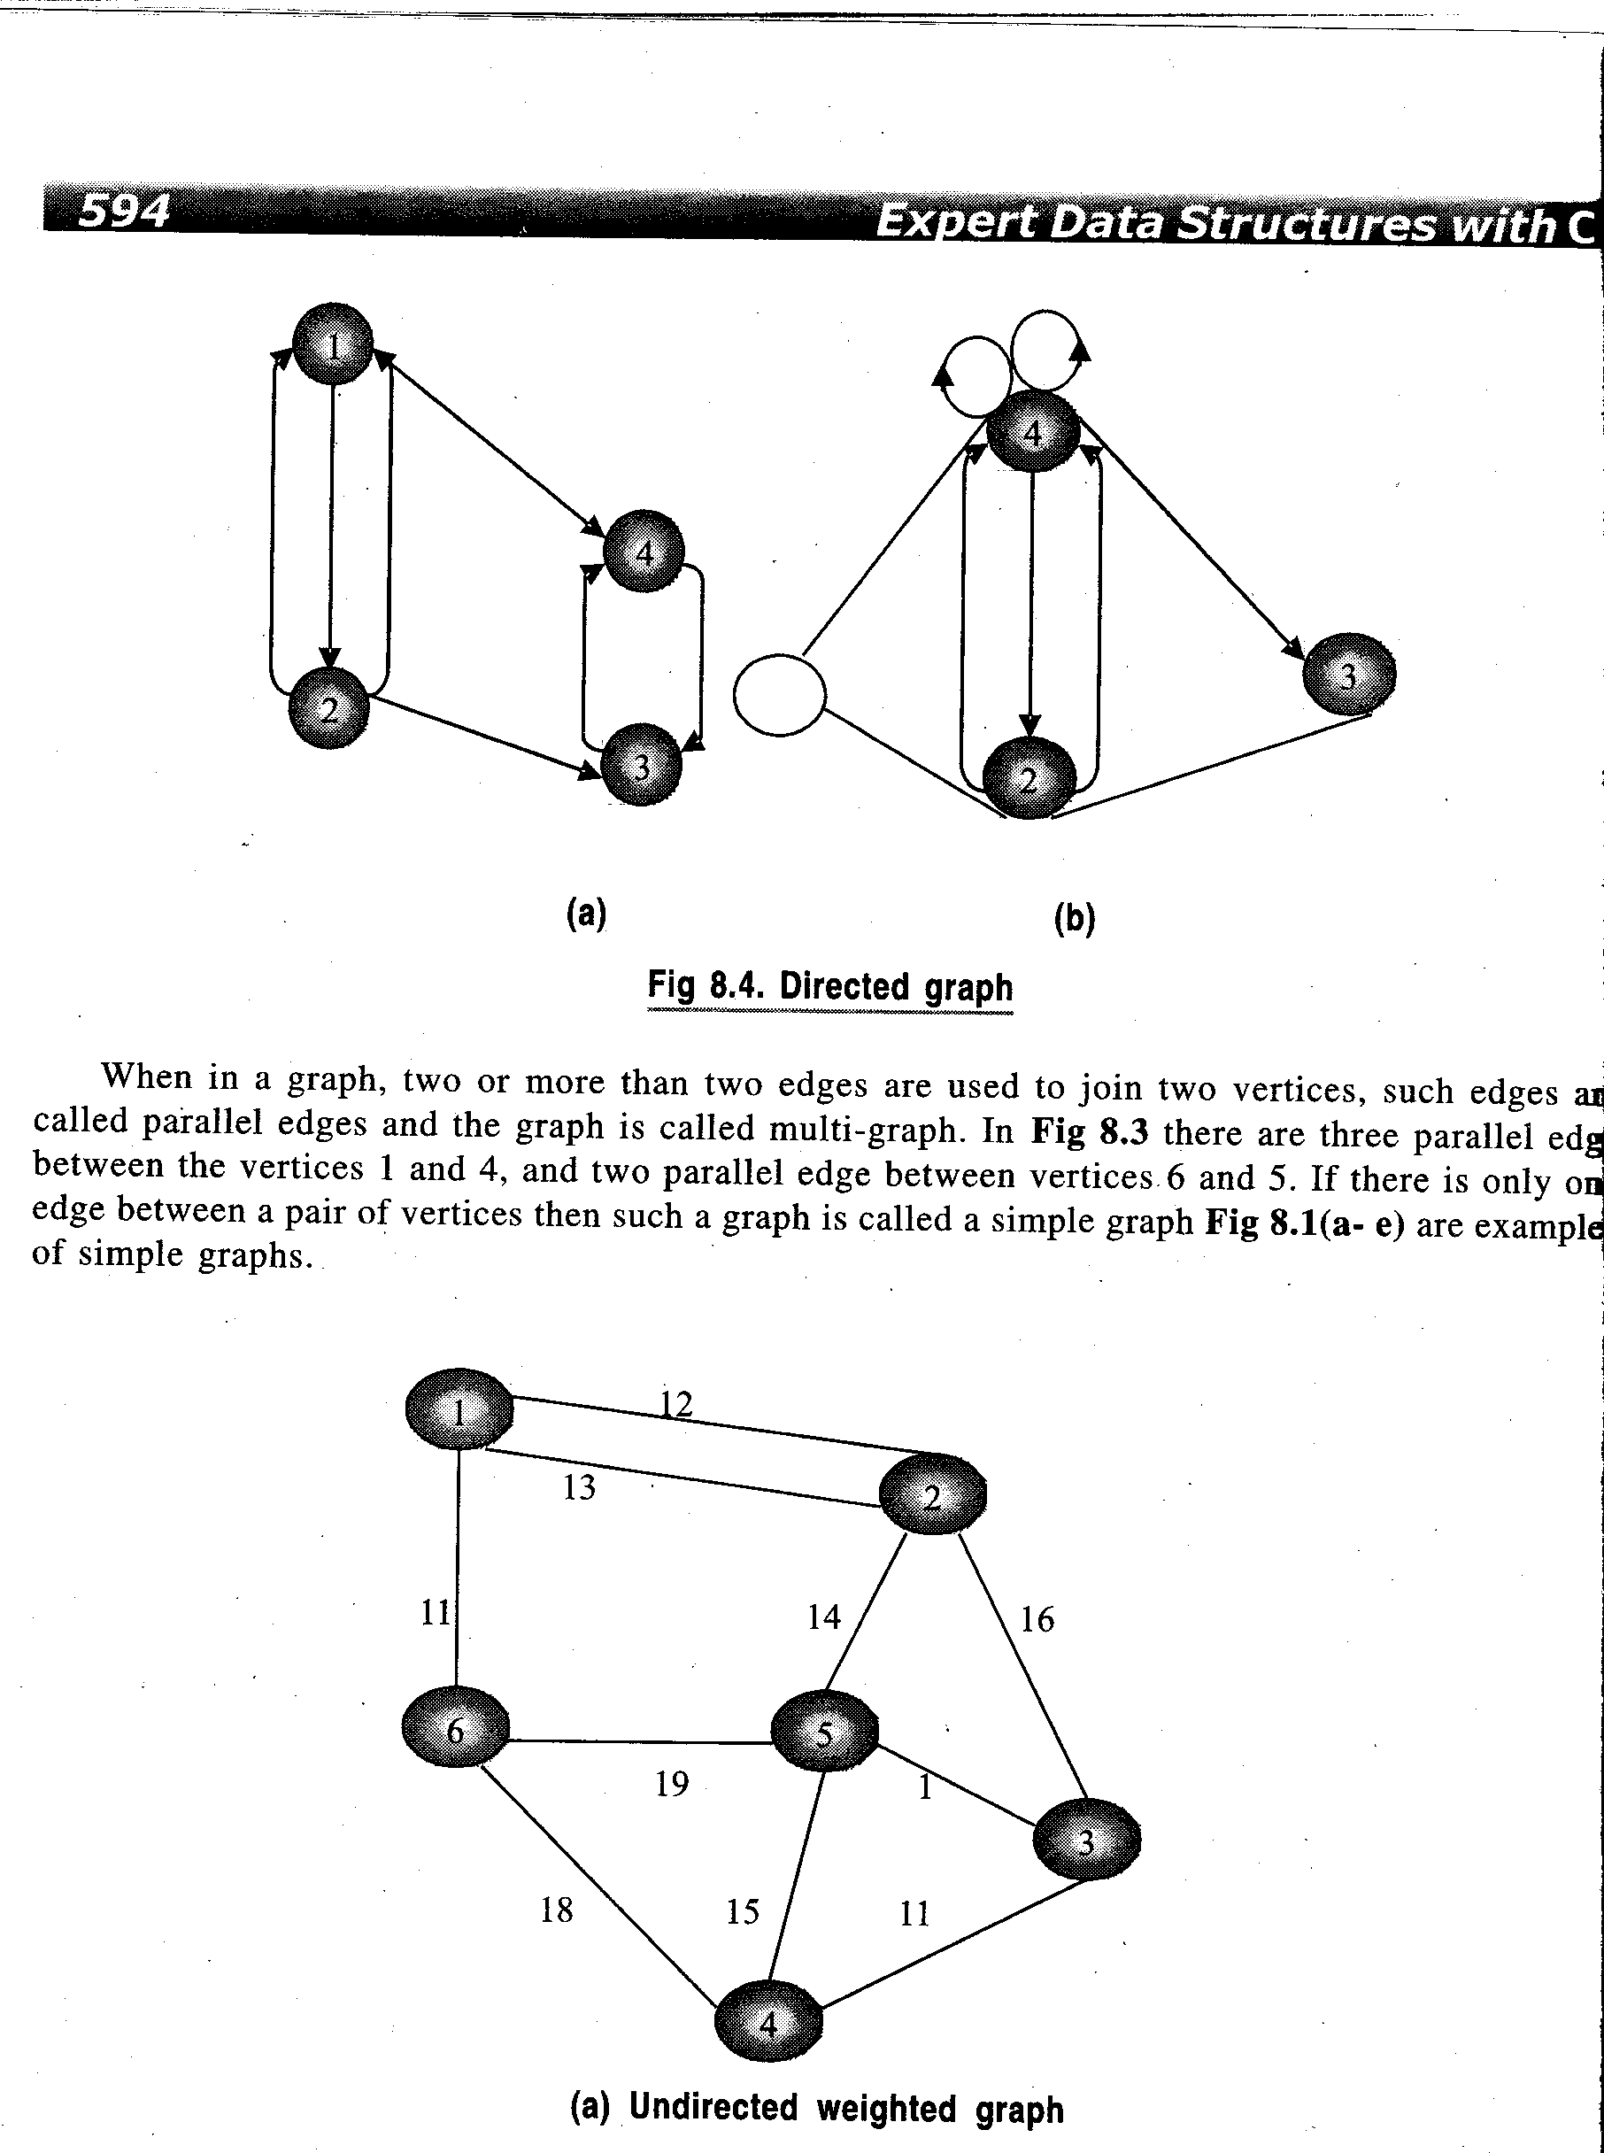
Directed Multi Graph
www.csemcq.com

Slide 9
Weighted Graph
www.csemcq.com

Slide 10
Representation of a graph-There are two main ways of representing a graph in memory. These are:
Sequential
Linked List
Sequential Representation- The graphs can be represented as matrices in sequential representation. There are two most common matrices. These are:
Adjacency Matrix
Incidence Matrix
The adjacency matrix is a sequence matrix with one row and one column devoted to each vertex. The values of the matrix are 0 or 1. A value of 1 for row i and column j implies that edge e_{ij} exists between v_{i} and v_{j} vertices. A value of 0 implies that there is no edge between the vertex v_{i} and v_{j}. Thus, for a graph with v₁,v₂,v₃………..v_{n} vertices, the adjacency matrix A=[a_{ij}] of the graph G is the n x n matrix and can be defined as:
www.csemcq.com

Slide 11
1 if v_{i} is adjacent to v_{j} (if there is an edge between v_{i} and v_{j})
a_{ij} =
0 if there is no edge between v_{i} and v_{j}
Such a matrix that contains entries of only 0 or 1 is called a bit matrix or Boolean matrix.
The adjacency matrix of the graph G does depend on the ordering of the nodes in G that is different ordering of the nodes may result in a different adjacency matrix. However the matrices resulting from different orderings are closely related in that one can be obtained from another by simply interchanging rows and columns
www.csemcq.com

Slide 12
Suppose G is an undirected graph. Then the adjacency matrix A of G will be a symmetric matrix i.e one in which a_{ij}=a_{ji} for every i and j.
If G is a multigraph, then the adjacency matrix of G is the m x m matrix A=(a_{ij}) defined by setting a_{ij} equal to the number of edges from v_{i} to v_{j.}
Consider an Adjacency matrix A representing a graph. Then A², A³……..A^{k} of Adjacency matrix A represent the matrices with path lengths 2,3……… k respectively. In other words, if
a_{k}(i,j)= the ijth entry of matrix A^{k}
then this entry represents the number of paths of length k from node v_{i} to v_{j. .}If now we represent a matrix B_{r} as
B_{r}=A+A²+A³………A^{k}
then each entry of B_{r} represent the number of paths of lengths r or less than r from node v_{i} to v_{j}
www.csemcq.com

Slide 13
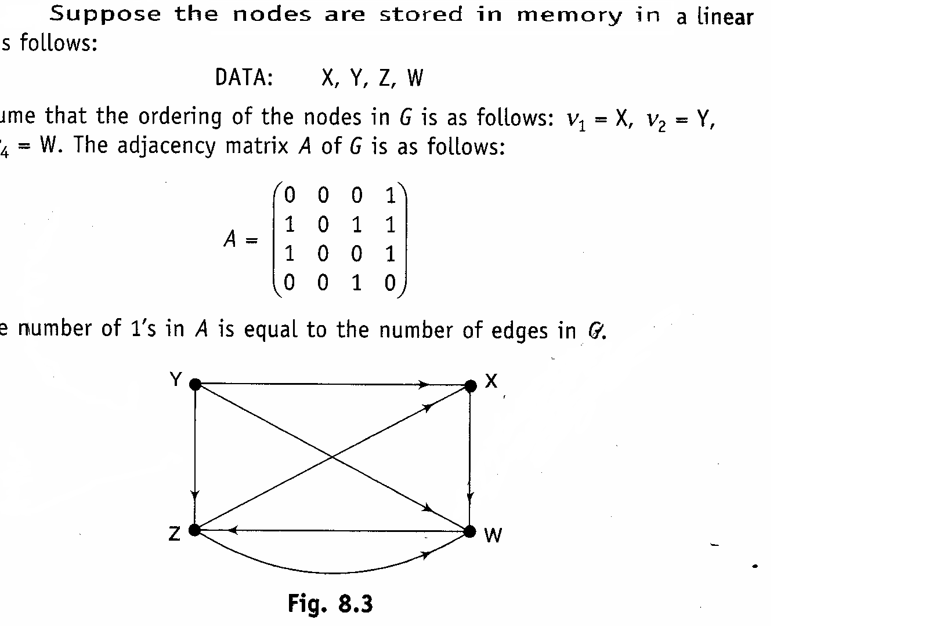
Example :Consider the graph G. Suppose the nodes are stored in memory in a linear array DATA as follows:
DATA: X,Y,Z,W
Then we assume that the ordering of the nodes in G as as v1=X, v2=Y,v3=Z, v4=W. The adjacency matrix A of G is
0 0 0 1
A= 1 0 1 1
1 0 0 1
0 0 1 0
www.csemcq.com

Slide 14
Path Matrix- Let G be a simple directed graph with m nodes, v₁,v₂,v₃………..v_{m}. The path matrix or reachability matrix of G is the m-square matrix P=(p_{ij}) defined as:
  1 if there is a path from v_{i} to v_{j}
  P_{ij}=
  0 Otherwise
  Suppose there is a path from v_{i} to v_{j}. Then there must be a simple
  path from v_{i} to v_{j} when v_{i} ≠ v_{j} or there must be a cycle from v_{i} to v_{j}
  when v_{i} = v_{j}. Since G has only m nodes such a simple path must be
  of length m-1 or less or such a cycle must have length m or less.
www.csemcq.com

Slide 15
Proposition:
Let A be the adjacency matrix and let P=(p_{ij}) be the path matrix of a digraph G. Then P_{ij}=1 if and only if there is a nonzero number in the Adjacency matrix in the ijth entry of the matrix.
B_{m} = A+ A²+ A³ +……. + A^{m}
www.csemcq.com

Slide 16
Linked representation of the graph- The sequential representation of the graph in memory i.e the representation of graph by adjacency matrix has a number of major drawbacks
It may be difficult to insert and delete nodes in Graph. This is because the size of array may need to be changed and the nodes may need to reordered which can lead to many changes in the matrix.
Also if the number of edges are very less, then, the matrix will be sparse and there will be wastage of memory.
Accordingly, graph is usually represented in memory by a linked representation also called an adjacency structure.
Specifically, the linked representation of graph contains two lists (or files), a node list NODE and an edge list EDGE, as follows:
Node list- Each element in the list NODE will correspond to a node in G(Graph) and it will be a record of the form:
www.csemcq.com

Slide 17
NODE | NEXT | ADJ
Here NODE will be the name or key value of the node, NEXT will be a pointer to the next node in the list NODE and ADJ will be a pointer to the first element in the adjacency list of the node, which is maintained in the list EDGE. The last rectangle indicates that there may be other information in the record such as indegree of the node, the outdegree of the node, status of the node during execution etc.
The nodes themselves will be maintained as a linked list and hence will have a pointer variable START for the beginning of the list and a pointer variable AVAILN for the list of available space
Edge List- Each element in the list EDGE will correspond to an edge of graph and will be a record of the form:
DEST | LINK
www.csemcq.com

Slide 18
The field DEST will point to the location in the list NODE of the destination or terminal node of the edge. The field LINK will link together the edges with the same initial node, that is, the nodes in the same adjacency list. The third area indicates that there may be other information in the record corresponding to the edge, such as a field EDGE containing the labeled data of the edge when graph is a labeled graph, a field weight WEIGHT containing the weight of the edge when graph is a weighted graph and so on.
A D
E
B C
Node | Adjacency List
A B C D E | B,C,D C C,E C
www.csemcq.com

Slide 19
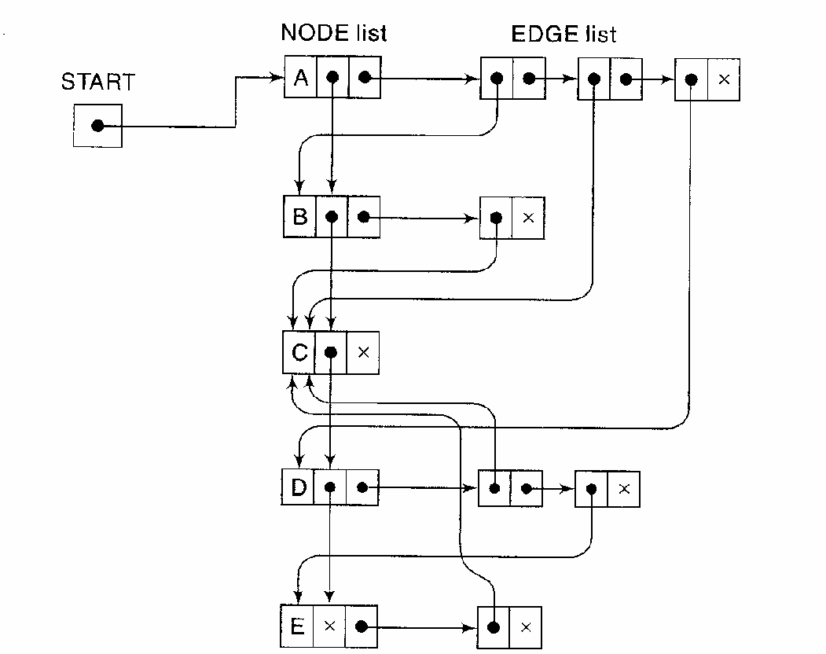
www.csemcq.com

Slide 20
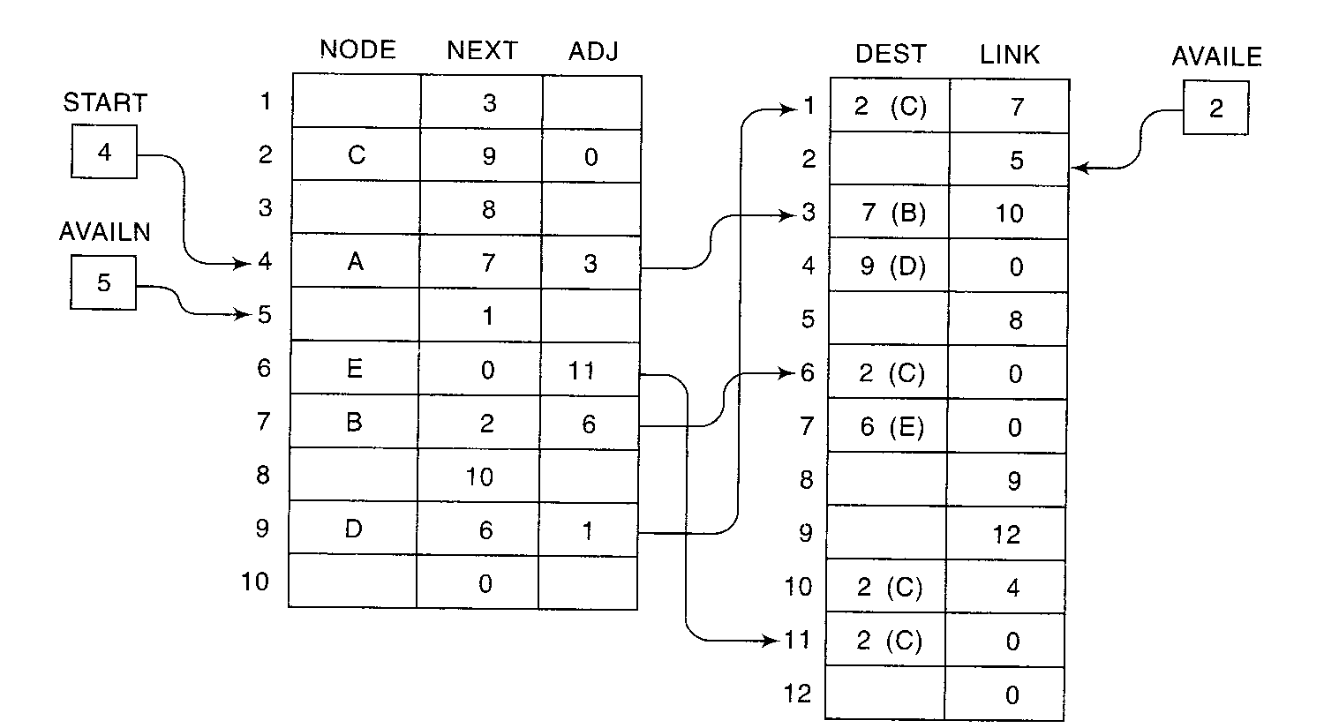
www.csemcq.com

Slide 21
Traversing a Graph- There are two standard ways of traversing a graph
Breadth-first search
Depth-First Search
The breadth-first search will use a queue as an auxiliary structure to hold nodes for future processing, and analogously, the depth-first search will use a stack
During the execution of algorithm, each node N of G (Graph) will be in one of the three states, called the status of N as follows:
STATUS=1: (Ready state) The initial state of the node N
STATUS=2: (Waiting state) The node N is one the queue or stack,
waiting to be processed
STATUS=3: (Processed state). The node N has been processed
www.csemcq.com

Slide 22
The general idea behind a breadth-first search beginning at a starting node A as follows:
Examine the starting node A
Examine all neighbors of A
Then examine all neighbors of neighbors of A and so on.
Keep track of neighbors of node and guarantee that no node is processed more than once. This is accomplished by using a queue to hold nodes that are waiting to be processed and by using a field STATUS which tells the status of any node.
The breadth-first search algorithm helps in finding the minimum path from source to destination node
www.csemcq.com

Slide 23
Algorithm: This algorithm executes a breadth-first search on a graph
G beginning at a starting node A. This algorithm can
process only those nodes that are reachable from A. To
examine all the nodes in graph G, the algorithm must be
modified so that it begins again with another node that is
still in the ready state
Step 1: Initialize all nodes to the ready state (STATUS=1)
Step 2: Put the starting node A in Queue and change its status to the
waiting state (STATUS=2)
Step 3: Repeat Steps 4 and 5 until Queue is empty:
Step 4: Remove the front node N of Queue. Process N and change the
status of N to the processed state (STATUS=3)
Step 5: Add to the rear of Queue all the neighbors of N that are in the
ready state ( STATUS=1) , and change their status to the
waiting state (STATUS=2)
[End of Step 3 Loop]
Step 6: Exit
www.csemcq.com

Slide 24
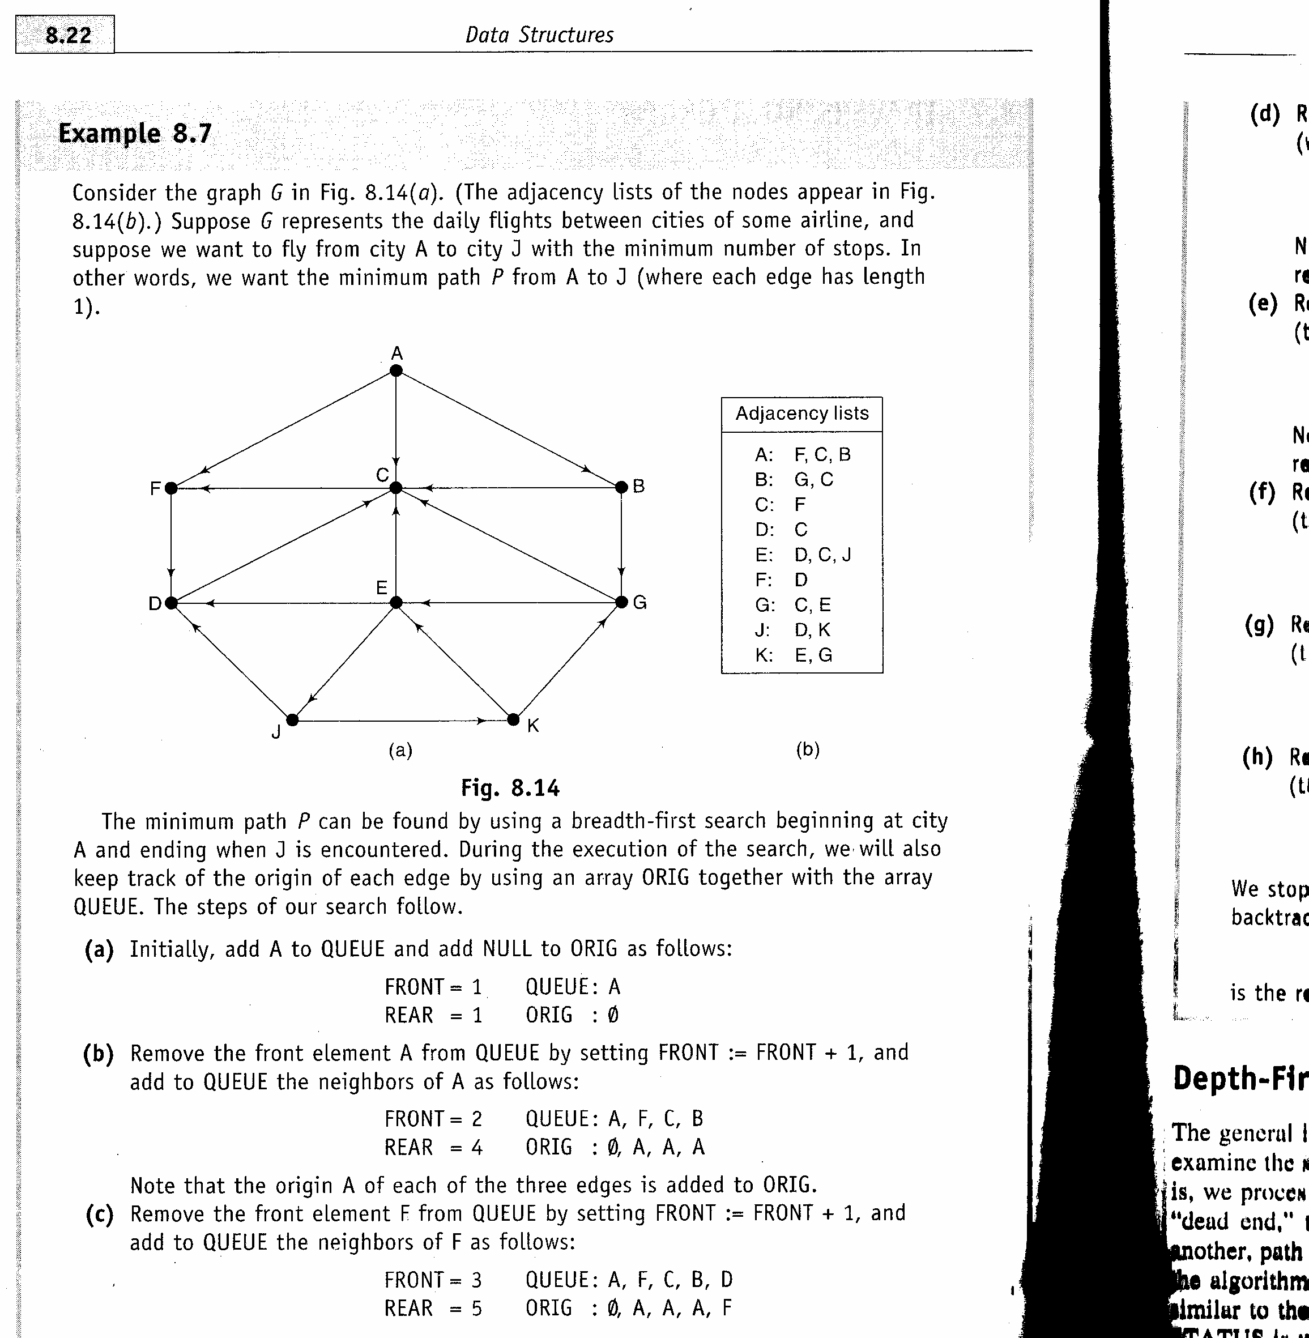
www.csemcq.com

Slide 25
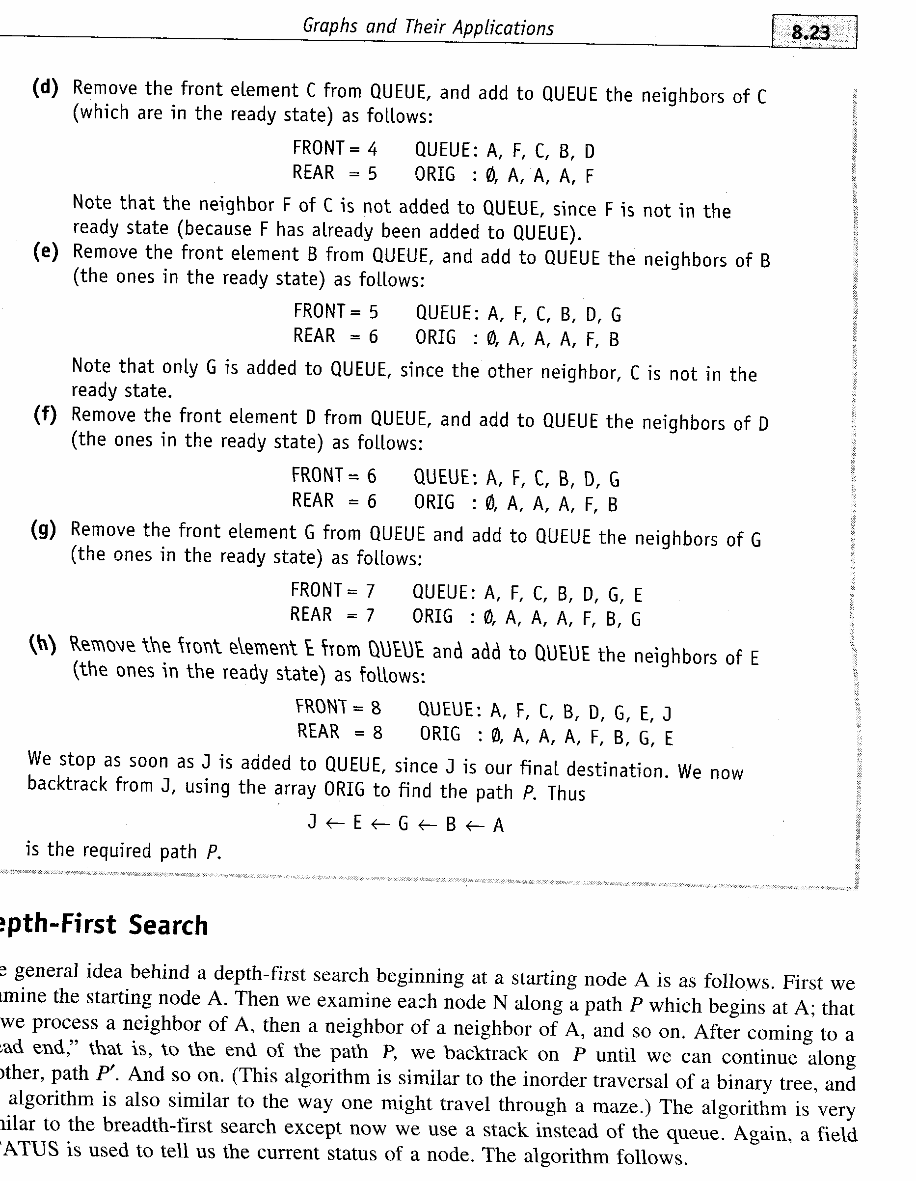
www.csemcq.com

Slide 26
Algorithm: This algorithm executes a depth-first search on a graph G
beginning at a starting node A. This algorithm can
process only those nodes that are reachable from A. To
examine all the nodes in graph G, the algorithm must be
modified so that it begins again with another node that is
still in the ready state
Step 1: Initialize all nodes to the ready state (STATUS=1)
Step 2: Push the starting node A onto STACK and change its status to
the waiting state (STATUS=2)
Step 3: Repeat steps 4 and 5 until STACK is empty
Step 4: Pop the top node N of STACK. Process N and change its status
to the processed state (STATUS=3)
Step 5: Push onto the STACK all the neighbors of N that are still in the
ready state (STATUS=1) and change their status to the waiting
state (STATUS=2)
[End of Step 3 Loop]
Step 6: Exit
Q:Using Previous Graph Print all nodes reachable from J using DFS.
www.csemcq.com

Slide 27
Difference between BFS and DFS
The BFS uses a queue for its implementation whereas DFS uses a stack
BFS is mostly used for finding the shortest distance between the two nodes in a graph whereas DFS is mostly used to find the nodes that are reachable from a particular node.
BFS is called breadth first search as first it processes a node then its immediate neighbors and so on. In other words, FIFO queue puts all its newly generated nodes at the end of a queue which means that shallow nodes are expanded before the deeper nodes. BFS traverses a graph breadth- wise. DFS first traverses the graph till the last reachable node then back tracks the nodes for processing. In other words, DFS expands deepest unexpanded node first first traverses the depth of the graph.
BFS ensures that all the nearest possibilities are explored first whereas DFS keeps going as far as it can then goes back to look at other options
www.csemcq.com

Slide 28
Dijkstra’s Algorithm- This technique is used to determine the shortest path between two arbitrary vertices in a graph.
Let weight w(vi ,vj) is associated with every edge (vi,vj) in a given graph. Furthermore, the weights are such that the total weight from vertex vi to vertex vk through vertex vj is w(vi,vj) + w(vj,vk). Using this technique, the weight from a vertex vs (starting of the path) to the vertex vt( the end of the path) in the graph G for a given path (vs,v1),(v1,v2),(v2,v3)…..(vi,vt) is given by w(vs,v1) + w(v1,v2) +w(v2,v3)+….+w(vi,vt)
Dijkstra’s method is a very popular and efficient one to find every path from starting to terminal vertices. If there is an edge between two vertices, then the weight of this edge is its length. If several edges exist, use the shortest length edge. If no edge actually exists, set the length to infinity. Edge(vi,vj) does not necessarily have same length as edge (vj,vi). This allows different routes between two vertices that take different paths depending on the direction of travel
www.csemcq.com

Slide 29
Dijkstra’s technique is based on assigning labels to each vertex. The label is equal to the distance (weight) from the starting vertex to that vertex. The starting vertex has the label 0 A label can be in one of the two states-temporary or permanent. A permanent label that lies along the shortest path while a temporary label is one that has uncertainty whether the label is along the shortest path.
Algorithm:
Step 1: Assign a temporary label l(v_{i})= ∝ to all vertices except v_{s} (the starting
vertex)
Step 2: [Mark v_{s} as permanent by assigning 0 label to it]
l(v_{s})=0
Step 3: [Assign value of v_{s} to v_{k} where v_{k} is the last vertex to be made permanent]
v_{k}=v_{s}
Step 4: If l(v_{i}) > l(v_{k}) + w(v_{k},v_{i}) [weight of the edge from v_{k} to v_{i}]
l(v_{i})= l(v_{k}) +w(v_{k},v_{i})
Step 5: v_{k}=v_{i}
Step 6: If v_{t} has temporary label, repeat step 4 to step 5 otherwise the value of v_{t} is
permanent label and is equal to the shortest path v_{s} to v_{t}
Step 7: Exit
www.csemcq.com

Slide 30

Dijkstra’s Algorithm
www.csemcq.com
Notes:
Obtain a network, and use the same network to illustrate the shortest path problem for communication networks, the max flow problem, the minimum cost flow problem, and the multicommodity flow problem. This will be a very efficient way of introducing the four problems. (Perhaps under 10 minutes of class time.)

Slide 31

∞
∞
2
4
4
0
2
2
1
1
2
3
∞
1
6
4
2
3
3
5
∞
∞
Initialize
Select the node with the minimum temporary distance label.
www.csemcq.com

Slide 32

2
∞
∞
2
4
4
0
2
2
1
1
2
3
6
∞
4
2
3
3
5
∞
∞
4
www.csemcq.com

Slide 33

2
∞
2
4
4
0
2
2
1
1
2
3
6
∞
4
2
3
3
5
4
∞
www.csemcq.com

Slide 34
6
2
∞
2
4
4
0
2
2
1
1
2
3
6
∞
4
2
3
3
5
4
∞
3
4
The predecessor of node 3 is now node 2
www.csemcq.com

Slide 35

2
6
2
4
4
0
2
2
1
1
2
3
6
∞
4
2
3
3
5
3
4
www.csemcq.com

Slide 36

2
6
2
4
4
0
2
2
1
1
2
3
6
∞
4
2
3
3
5
3
4
d(5) is not changed.
www.csemcq.com

Slide 37
2
6
2
4
4
0
2
2
1
1
2
3
6
∞
4
2
3
3
5
3
4
www.csemcq.com

Slide 38
2
6
2
4
4
0
2
2
6
1
1
2
3
6
∞
4
2
3
3
5
3
4
d(4) is not changed
www.csemcq.com

Slide 39
2
6
2
4
4
0
2
2
1
1
2
3
6
6
4
2
3
3
5
3
4
www.csemcq.com

Slide 40
2
6
2
4
4
0
2
2
1
1
2
3
6
6
4
2
3
3
5
3
4
d(6) is not updated
www.csemcq.com

Slide 41
2
6
2
4
4
0
2
2
1
1
2
3
6
6
4
2
3
3
5
3
4
There is nothing to update
www.csemcq.com

Slide 42

2
6
2
4
4
0
2
2
1
1
2
3
6
6
4
2
3
3
5
3
4
All nodes are now permanent
The predecessors form a tree
The shortest path from node 1 to node 6 can be found by tracing back predecessors
www.csemcq.com

